Slide 1

Prescription Label Reading
MINOR PROJECT
Project No. - 63
Swapnil Pant 201B278
Satyam Thakur 201B244
Utkarsh Mathur 201B294
Project Guide :
Dr. Nileshkumar R. Patel

Slide 2
Table of Contents
Serial No. | Title | Slide No.
1 | Introduction | 3
2 | Problem Statement | 4
3 | Solution | 5
4 | Block Diagram | 6
5 | What is OCR? | 7
6 | Technologies Used | 8 - 12
7 | Sample UI | 13
8 | Learning Outcomes | 14
9 | Target (until next Presentation) | 15
10 | References | 16

Slide 3

INTRODUCTION
Doctors in India are too busy to write digital prescriptions.
Prescription on paper can be tough to read and understand for the common folks.
After various attempts by our government, still this problem persists
Prescription reading will help solve the problem caused due to misinterpretation of prescriptions.

Slide 4
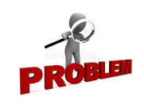
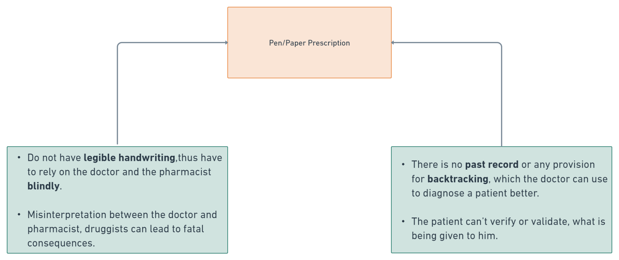
Problem Statement

Slide 5
Expected Outcome from this Project
SOLUTION
To build a solution that will recognize and identify the text in the prescriptions and should read out the name of medicines and dosage limits to the patients.
To build a deployable user interface or to expose our entire solution as an API.

Slide 6
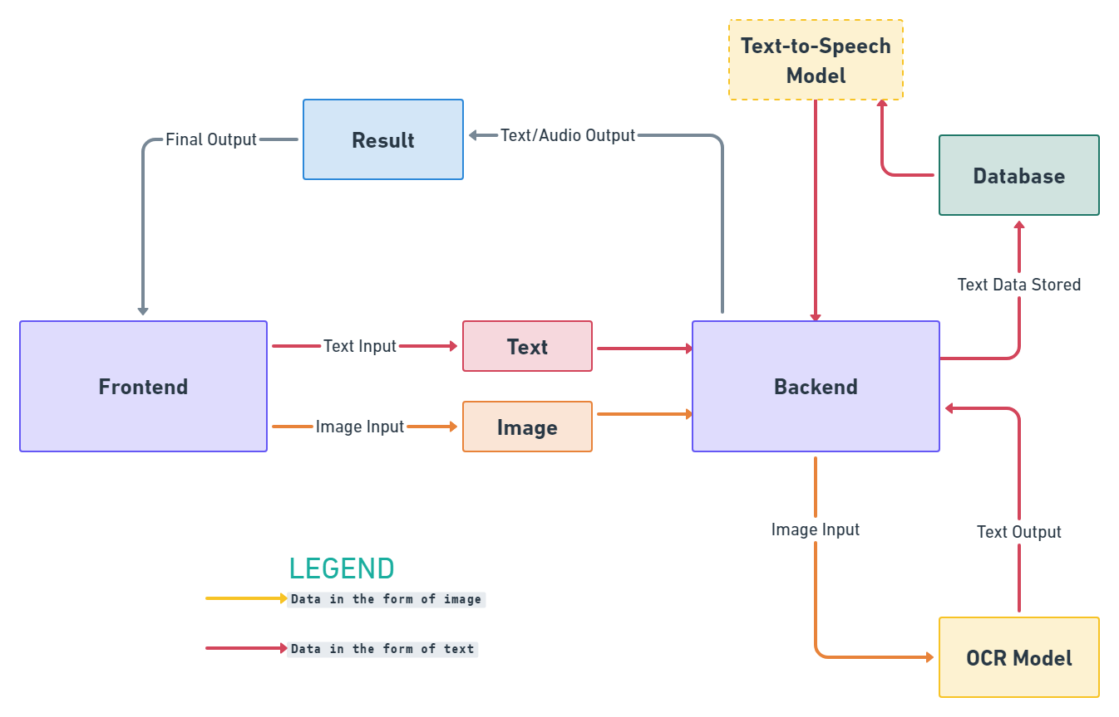
BLOCK DIAGRAM

Slide 7
What is OCR? And how does it work?
OCR stands for Optical Character Recognition/
It is the process that converts an image of text into a machine-readable text format.
The OCR engine works by using the following steps:
Image acquisition
Preprocessing
Text recognition
Pattern matching
Feature extraction
Post processing

Slide 8

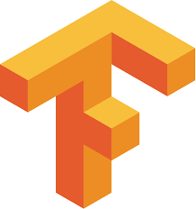
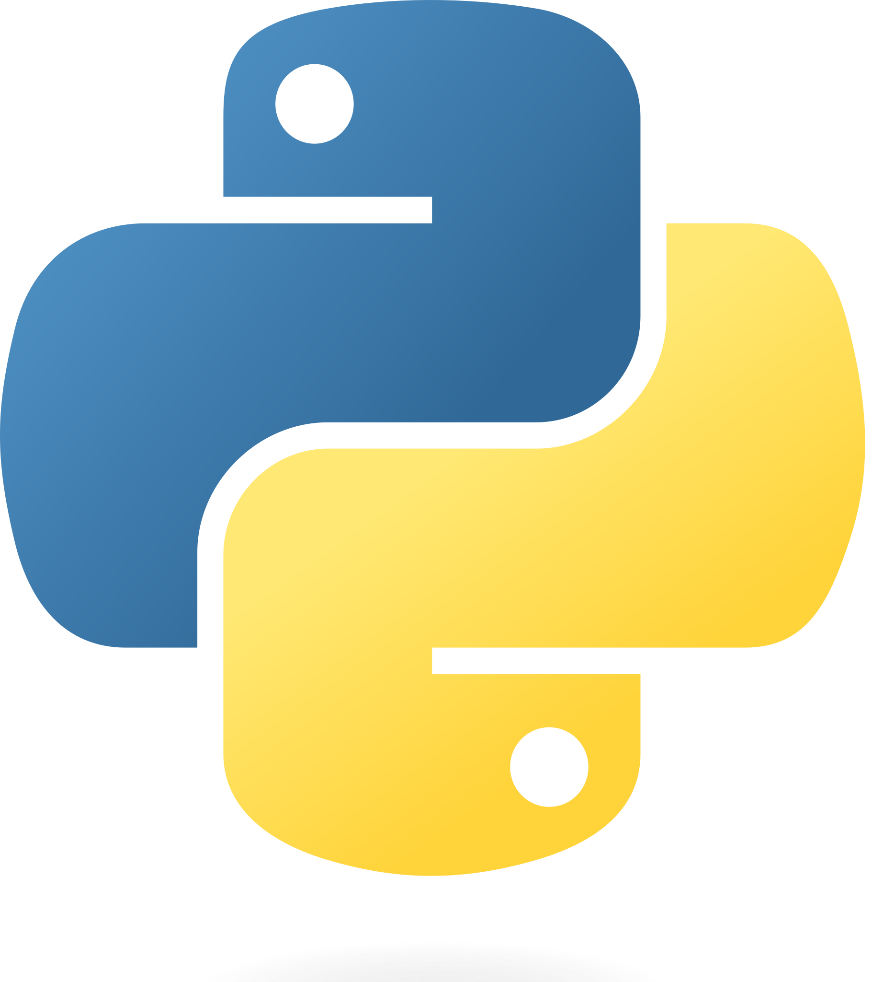
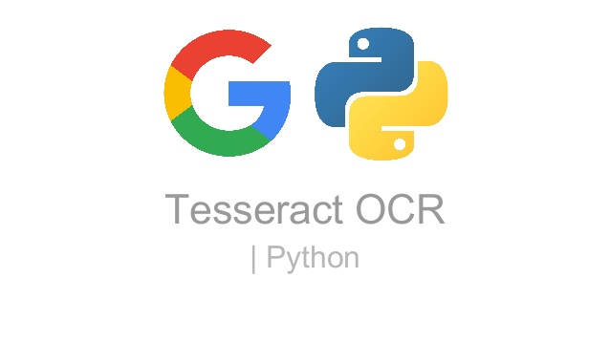
Tech Stack ( for AI models)
Keras
Tensorflow
PyTesseract
Python

Slide 9
Python
PyTesseract
OpenCV - Python open-source library used for computer vision in Artificial intelligence and Machine Learning.
The purpose of computer vision is to understand the content of the images.
Python-tesseract - an Optical Character Recognition (OCR) tool for Python.
Will read and recognize the text in images, license plates etc.

Slide 10

Keras
Tensorflow
Keras - an open-source software library that provides a Python interface for artificial neural networks.
Acts as an interface for the TensorFlow library.
TensorFlow - an open source framework to run machine learning, deep learning and other statistical and predictive analytics workloads.

Slide 11


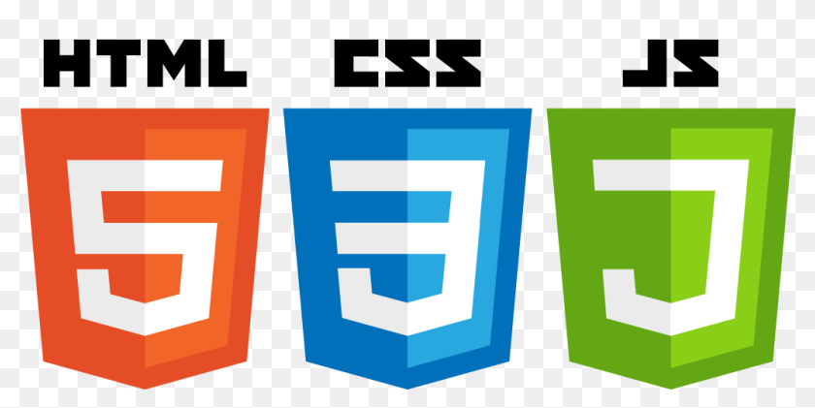

Tech Stack
(Front-End)
React.js
HTML, CSS, JS
Flask

Slide 12
React.js
Flask
An open-source JavaScript framework and library.
Uses - building interactive user interfaces and web applications efficiently.
A micro web framework written in Python.
Uses - building scalable network applications.

Slide 13
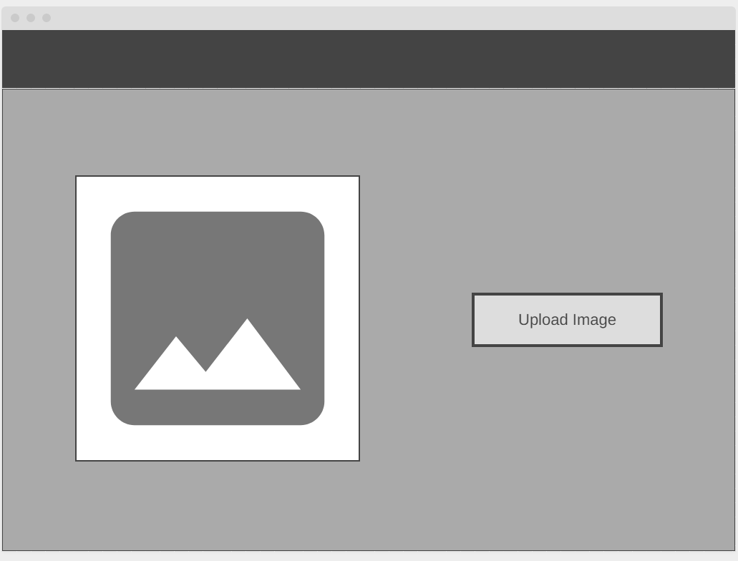
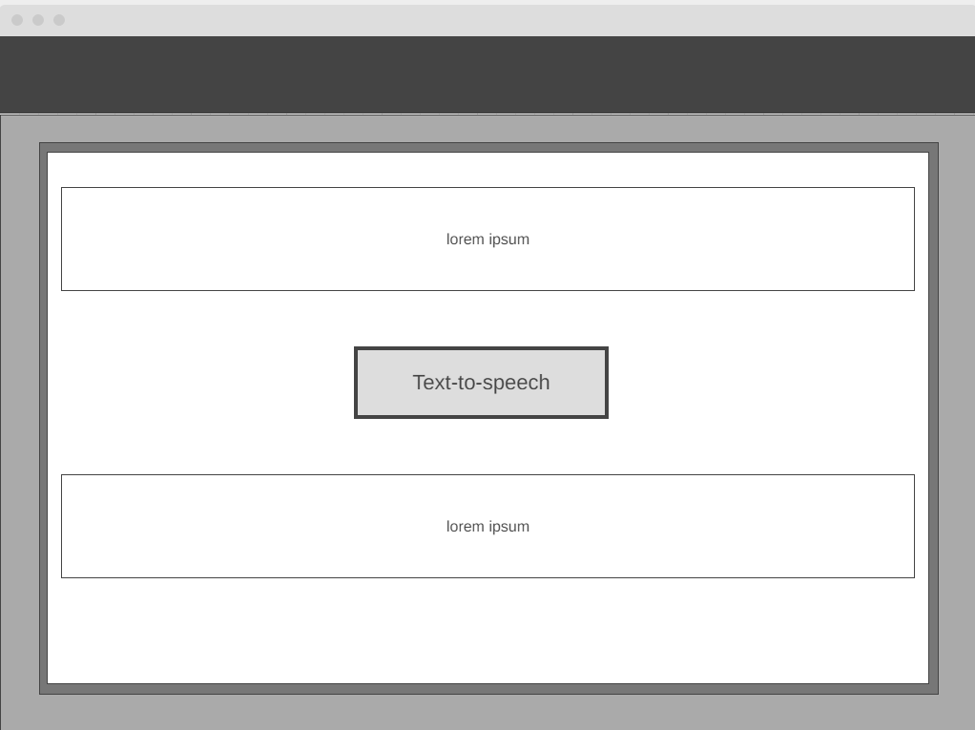
Sample UI

Slide 14
Learning Outcomes
To gain a solid understanding of Machine Learning fundamentals.
Learn the principles of deep learning and computer vision.
Know a variety of Optical Character Recognition Models thoroughly.
Learn how to deploy scalable applications and combine machine learning models with the front end.

Slide 15
Target (until Next Presentation)
Make an interactive application that is easy to use.
Prepare and train our optical character recognition working models (OCR).
Test the accuracy of our most recent models.

Slide 16
References :
Automating data extraction from prescription document images to reduce human error (MIT Research Paper)
Link: https://dspace.mit.edu/handle/1721.1/128575
Health Literacy Level and Comprehension of Prescription and Nonprescription Drug Information
Link: https://www.mdpi.com/1660-4601/19/11/6665
Klippa - Medical prescription OCR & data capturing
Link: https://www.klippa.com/en/ocr/medical-documents/medical-prescription/

